Slide 1
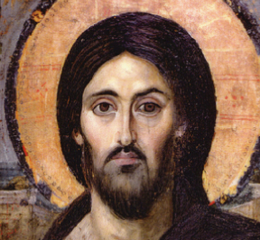
CATHOLICISM : The New Evangelization
Managing Challenging Personalities
Role Playing Exercise

Slide 2
Role Playing – Set Up
Show the Introduction segment on the first DVD (15 minutes) to the group of discussion leaders/facilitators
Have everyone take about 45 minutes to complete the questions in the study guide for Lesson 1.
Assemble everyone into one discussion group (or two groups, if you have more than 10 leader/facilitators)
Have 4-6 people choose a role to play during the discussion of the questions (see the descriptions of the roles that follow).
--Be sure to have at least two people who are not playing a specific role and are responding as they would naturally.
--Someone in the group must choose to be Group Leader
--Use the Assistant Group Leader role only if you have 9-10 people

Slide 3
Role Playing – Group Discussion
Allow 45 minutes for the group to discuss the questions from Lesson 1 – Part 1. The Group Leader presents the questions to the group just as he/she would during a regular session.
The group works through the questions with those playing roles acting as best as they can like the role chosen.
Everyone takes notes (written or mental) about the approaches used
Debrief discussion afterwards to capture and summarize learning for facilitators

Slide 4
Facilitator Roles
Group Leader
Assistant Group Leader
Facilitates group
Asks questions from lesson
Doesn’t answer questions with own thoughts, but seeks answers from the group
Supplies resources to aid in understanding content
Manages personalities/group dynamics
Helps Group Leader manage discussion and personalities
Provides pastoral care for group members
Time keeper
Supplies short “thought starter” answers if discussion is unproductive

Slide 5
Talkative Participant
Role Profile
Facilitator Options
Prefers to talk rather than listen
Usually speaks first when question is asked by facilitator
Can try to dominate group
Doesn’t try to understand need for others to share
Often subconsciously sits opposite Group Leader to assert own leadership role
Make your seat clear head of table – no one opposite you
OK to interrupt: “Thanks, Joe. Let’s hear what someone else thinks.”
Physical cue: Put hand on shoulder and repeat above phrase
Talk to privately about allowing all to speak

Slide 6
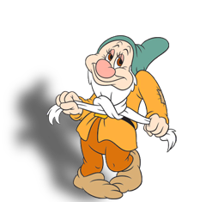
Quiet Participant
Role Profile
Facilitator Options
Prefers to listen rather than talk
Can be shy or introverted
Can be distracted or unprepared
Remind everyone to complete questions ahead
Encourage everyone to complete written work to be well prepared and have time for reflection
Encourage everyone in group to find one question each week to answer
Call privately to make sure all is OK

Slide 7
Experienced Participant
Role Profile
Facilitator Options
Lots of religious training or formation experience
Can be well-meaning: wants to share knowledge and teach others
Tends to lecture or talk down to less experienced without even realizing his/her tone
OK to interrupt: “Thanks, Joe. Let’s hear what someone else thinks.”
Ask for sources of info and links to resources provided
Talk to privately if lecturing or talking down to others

Slide 8
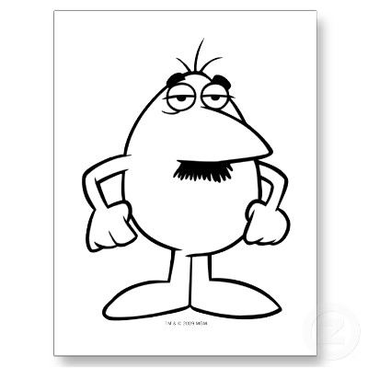
Challenging Participant
Role Profile
Facilitator Options
Asks lots of hard questions
Can play the devil’s advocate or just have honest questions
Can be confrontational with others in the group
Often has hidden issues with the Church
If question is valid, throw it to the group.
If not valid, put it in the “parking lot” to be discussed “later if we have time.”
If confrontational to a certain individual in the group, move to another group
Talk to privately to uncover hidden issues; recommend talking to priest if necessary

Slide 9
Off the Topic Participant
Role Profile
Facilitator Options
Easily distracted
Brings up current events or wants to chat about things outside of the lesson topics
Can be focused on one issue (e.g., pro life) and often forces it into the discussion
Repeat the lesson question or restate the correct topic
Put off-topic in the “parking lot” to be discussed “later if we have time.”
If a valid, but off-topic question, write it down and do research
If harping on one issue always, talk to privately

Slide 10
CATHOLICISM Study Program

